Slide 1
Hostel Managment System
Mini Project

Slide 2
PRESENTED BY,
1. Vinod Kumar .L - 950019104050
2. Kaikondar .S - 950019104019
3. Basvan .V - 950019104009
4. Sathees Kumar.K - 950019104302
Under the guidance of:
Dr.S.Sabena AP/CSE

Slide 3
ABSTRACT
✦ HOSTEL MANAGEMENT SYSTEM is proposed to reduce the problems faced by the traditional systems .
✦ The proposed system is designed to limit the human works and make hostel allocation much easier for students and hostel administrators.
✦ This system includes the following modules : Student Registration,
Leave Letter Management, Mess billing, Room Management.
✦All the events and activities that take place in the college is updated regularly by the admin.

Slide 4
OBJECTIVE
To Develop a Web app for Hostel Management System which can automate all the manual operations of the hostel.

Slide 5
TOOLS
Language:
Frontend: Html, CSS, JavaScript, Bootstrap.
Backend: Python/PHP , MySQL.
IDE: VSCodium,Neovim.

Slide 6
REQUIREMENT SPECIFICATIONS
Hardware Requirements:
Processor : i3 7th generation.
RAM : 4.00GB.
Hard Disk : 256 GB & Above.
Monitor.
Mouse.
Keyboard.
Software Requirements:
Operating System : Windows 10 , Ubuntu.
Language : HTML, CSS, PHP, JavaScript.
Database : MySQL.
Server : Xampp.

Slide 7
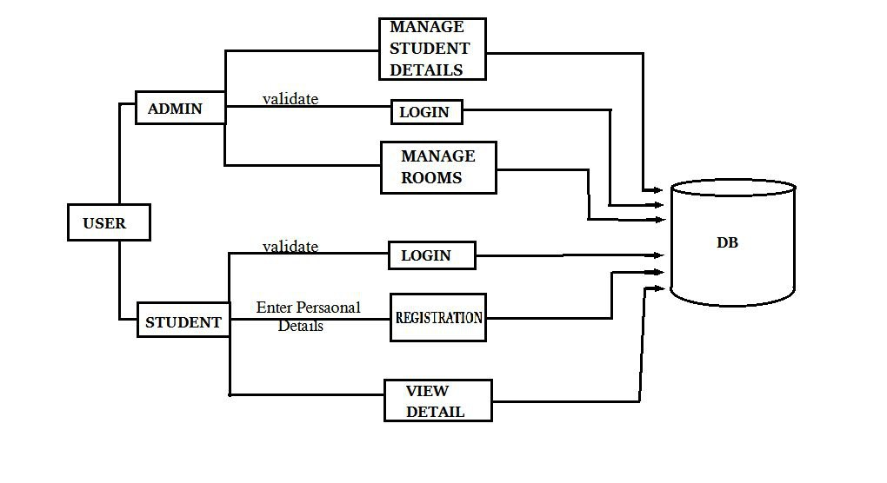
ARCHITECTURAL DESIGN FOR THE PROPOSED SYSTEM
Architecture Diagram:

Slide 8
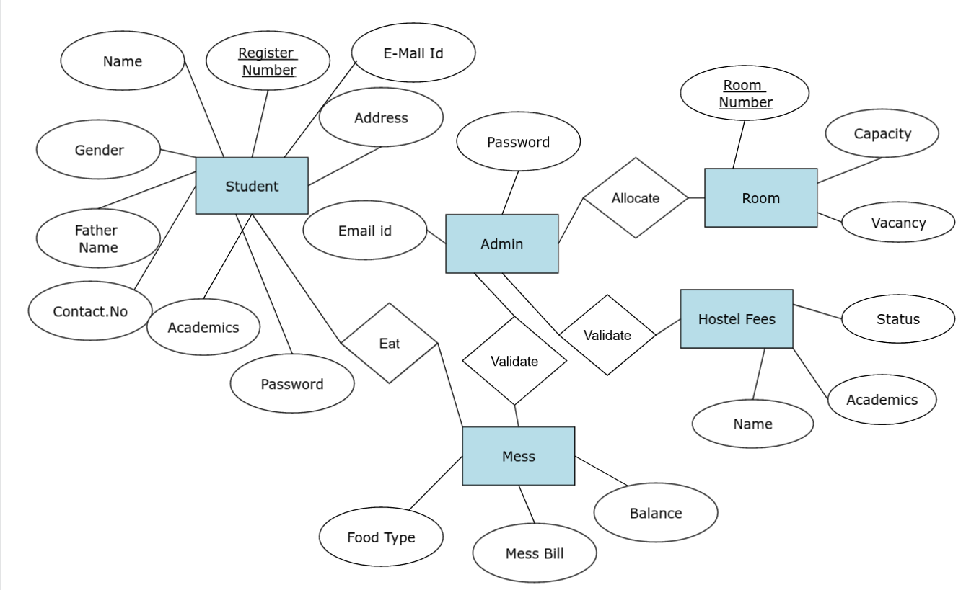
Entity Relationship Diagram:

Slide 9
PROPOSED WORK
✦ The proposed system is the computerized version of existing system.
✦ This system automates all the activities occurring in the hostel.
✦ There is no redundancy of data.
✦ The proposed system will easily handle all the data and the work done by the existing system.
✦ This system is easy to maintain records in the hostel.
✦ Therefore the proposed system eliminates the drawbacks of the traditional system to a great extent and it provides tight security to data.

Slide 10
LIST OF MODULES
✦ Administration Module.
✦ Student Registration Module.
✦ Room Management Module.
✦ Mess Bill Management Module.
✦ Leave Letter Management Module.

Slide 11
MODULES IN DETAILS
Administration Module:
✦ Administrator has to maintain data of every student profile in the database.
✦ Only the authorized user is allowed to access the information to the system by providing username and password.
✦ The administrator can view and update their profile to make any changes.
✦ They can also change their password which requires the old password.
✦ He/She can allot different students to the different hostels.
✦ This module determines the status of the fees payment.The administrator can edit the details of the students & modify student records.

Slide 12
Student Registration Module
✦ This module is used to store students records. This module provides a form to the students which can be filled by them and submitted to the hostel authorities.
✦ The student registration form consists of details of the students such as registration number, name, date of birth,address, gender, phone number, year, class , room no,guardian name and phone number.
✦ Here the details are entered and updated. These details are verified by hostel authorities before allotting the students to the respective hostel rooms.

Slide 13
Room Mangement Module
✦ Room allotment is an essential part of hostel management system.
✦ Students can be provided hostel accommodation based on the availability of rooms. Manual allocation of rooms can be very difficult.
✦ Therefore the proposed system makes this task easier and error free.
✦ In this module, the room number is allocated to students in the hostel and the details of the each student are maintained and updated regularly.

Slide 14
Mess Bill Mangement Module
✦ The proposed system helps the user to access all the functionalities of the mess in hostel.
✦ In this module, the mess item expenditure for each student in the hostel is calculated for each month and the mess bill for each student in calculated and displayed.
✦ It keeps tracks of all transactions related to mess. The administrator
checks bills if there are bills which are not paid by student, then he/she
can take an appropriate action.
✦ This will help the management to handle mess bill generation,
payment collections very easily.

Slide 15
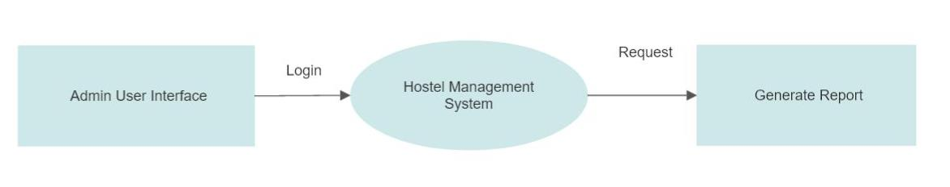
SYSTEM DESIGN
Data Flow Diagram
Level 0 : Interaction Between User and System.

Slide 16
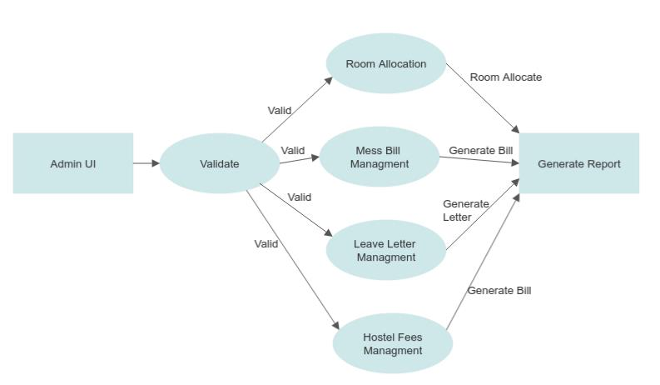
Level 1: Modules of Hostel Management System

Slide 17
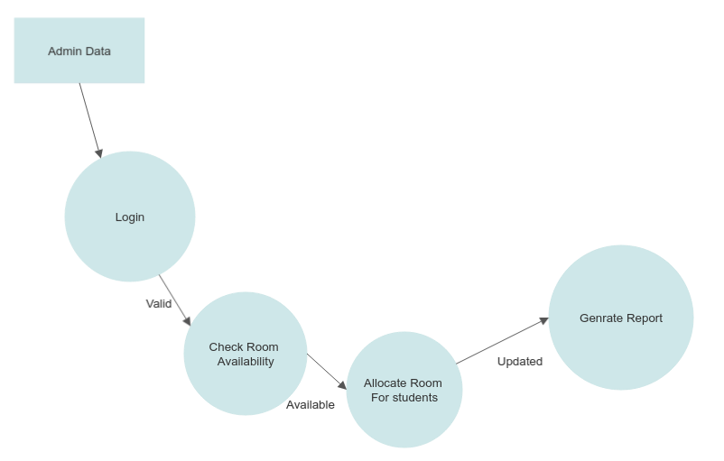
Level 2 :Room Management Module

Slide 18
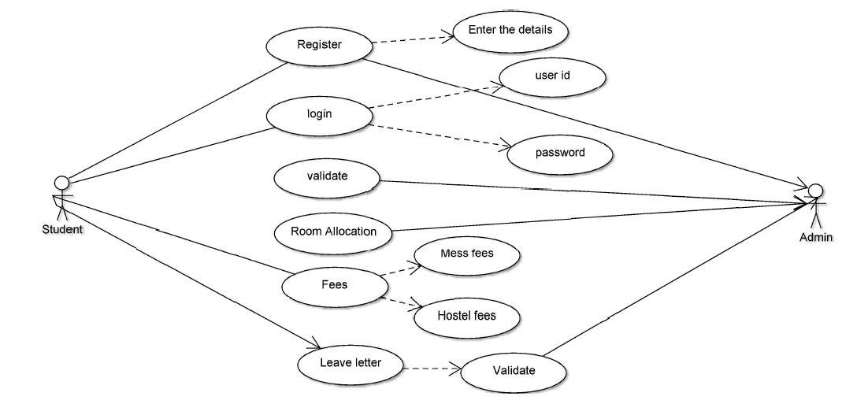
Use Case Diagram:

Slide 19
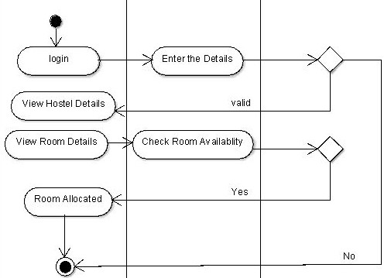
Activity Diagram:
Student System Admin

Slide 20
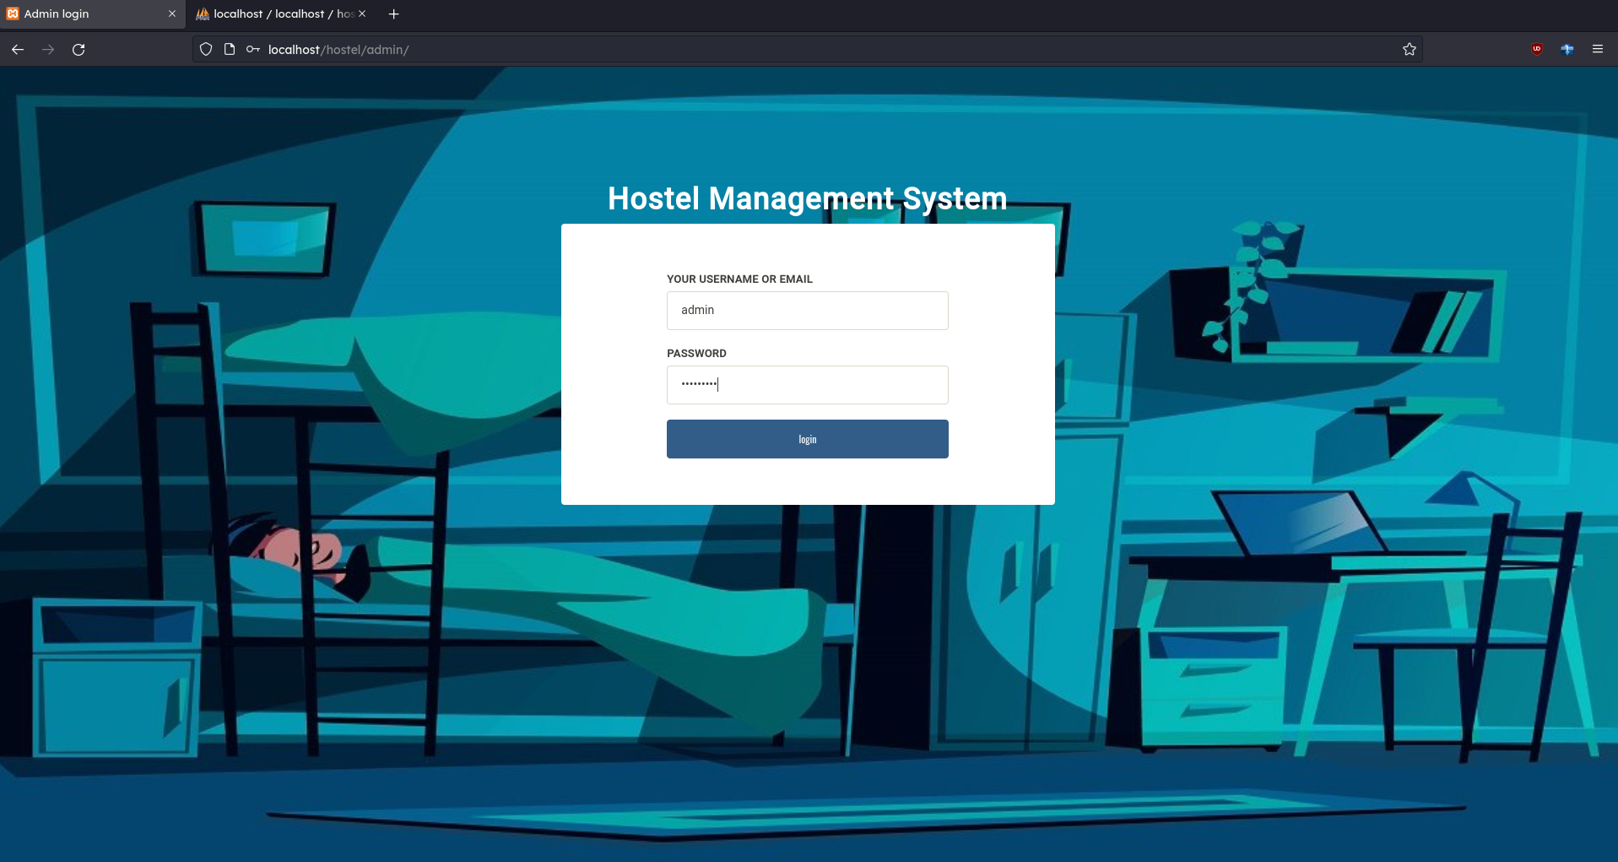
100% Completion :
Admin Login Page:

Slide 21
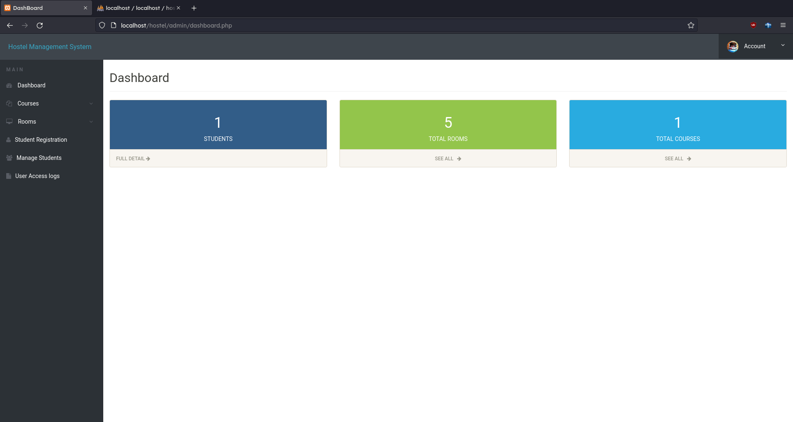
100% Completion :
Admin Dashboard:

Slide 22
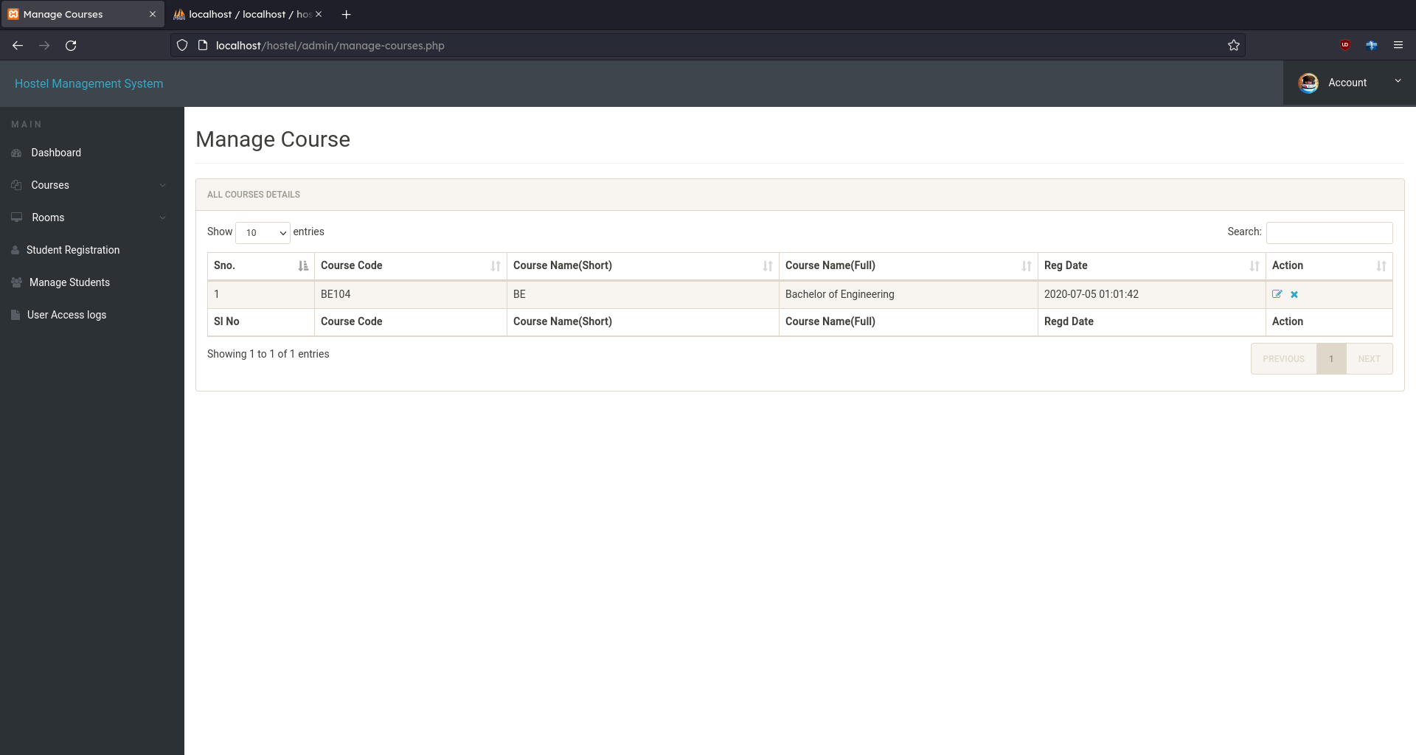
100% Completion :
Admin Manage Course:

Slide 23
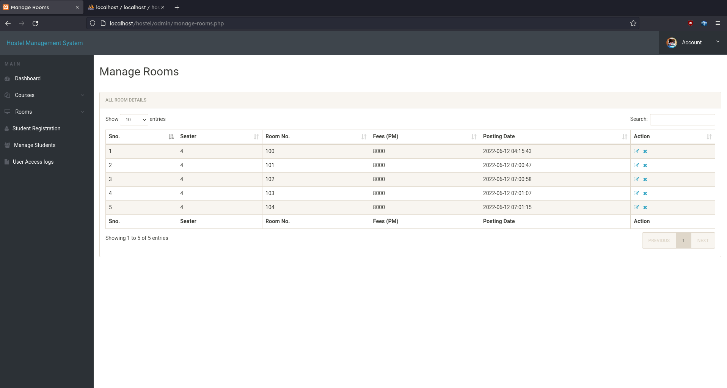
100% Completion :
Admin Manage Room:

Slide 24
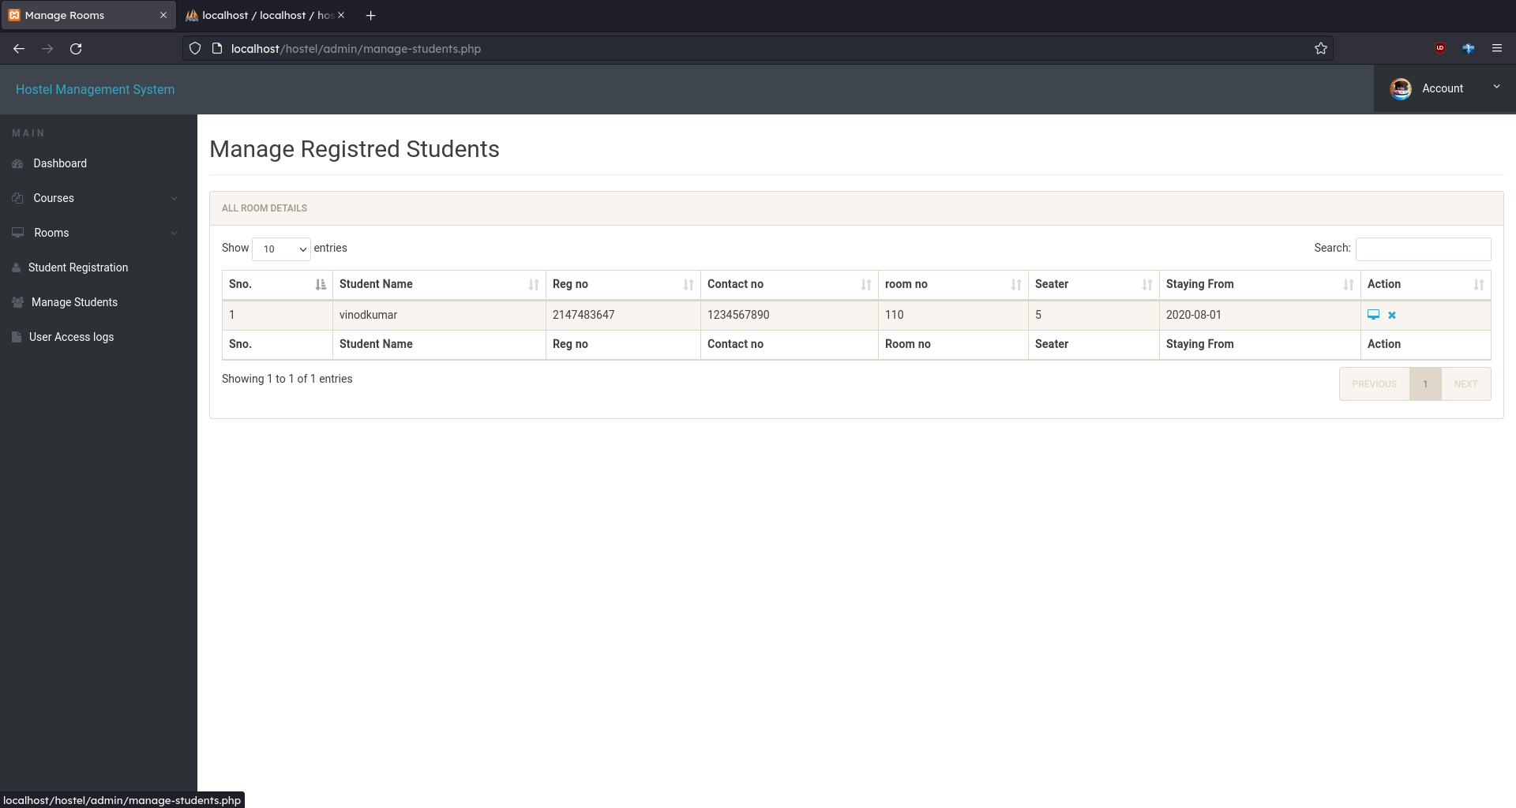
100% Completion :
Admin Manage Student:

Slide 25
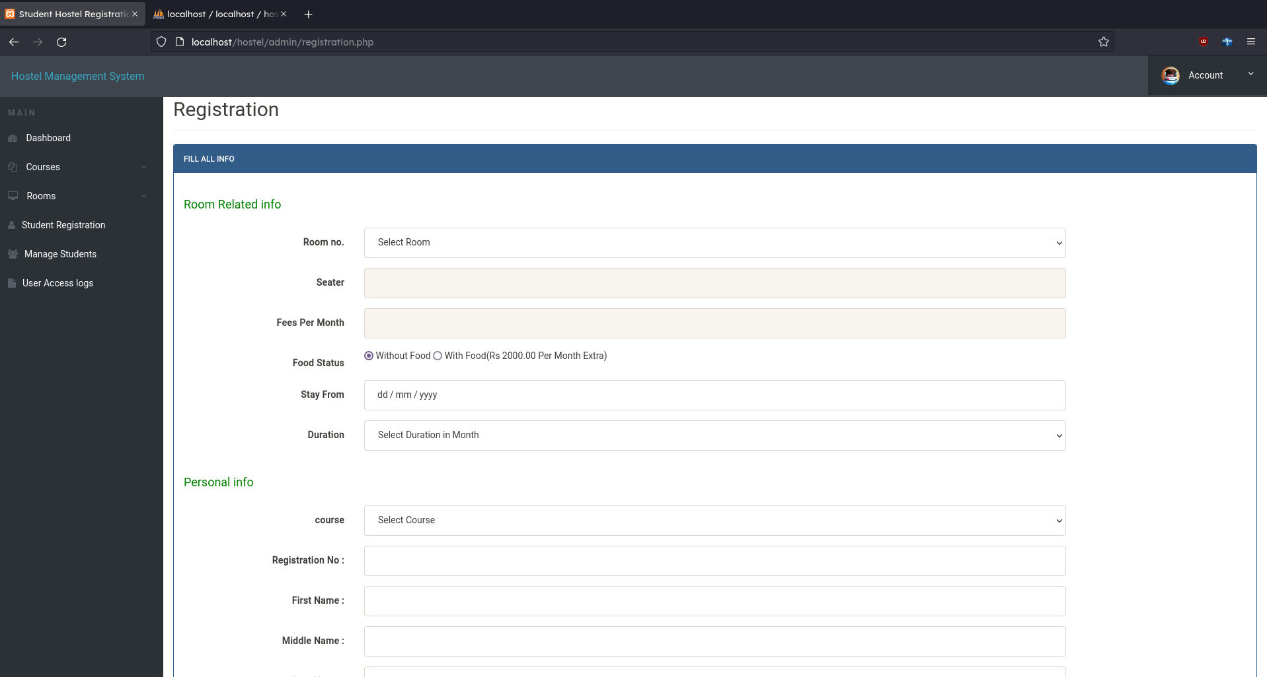
100% Completion :
Admin Register Student:

Slide 26
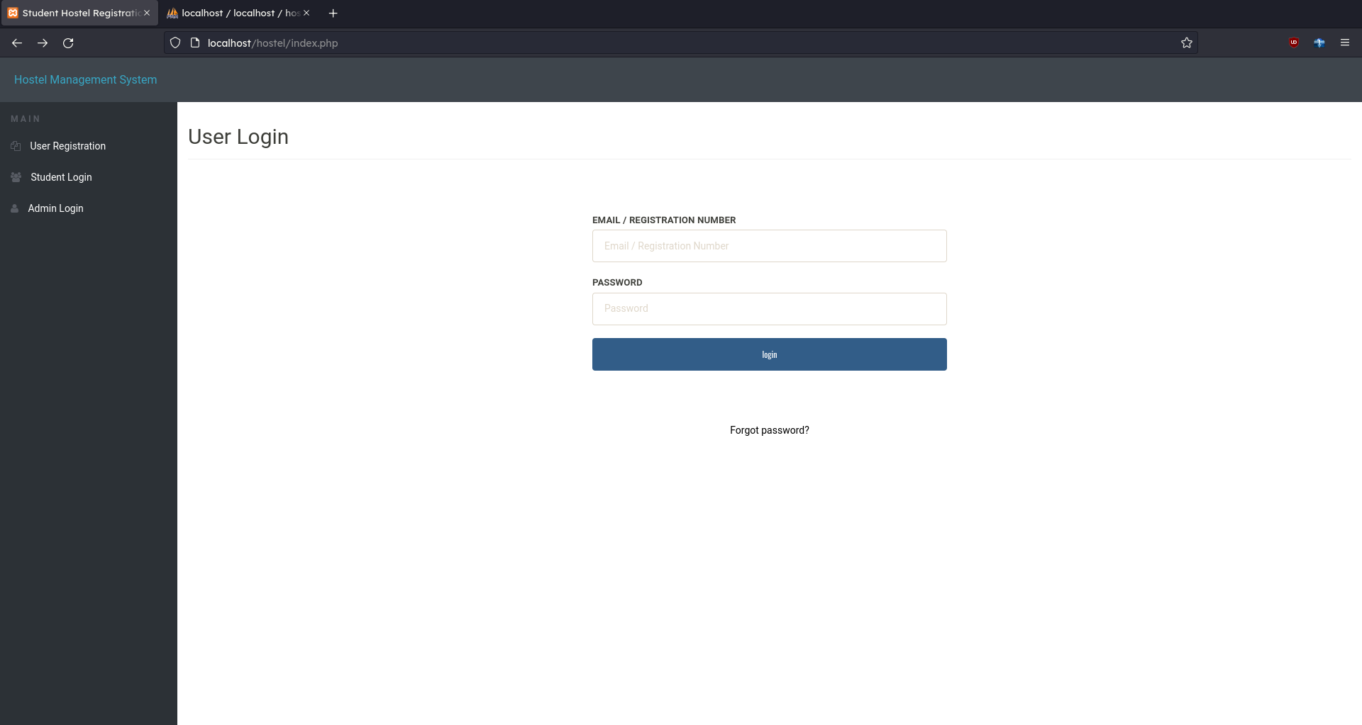
100% Completion :
Student Login:

Slide 27
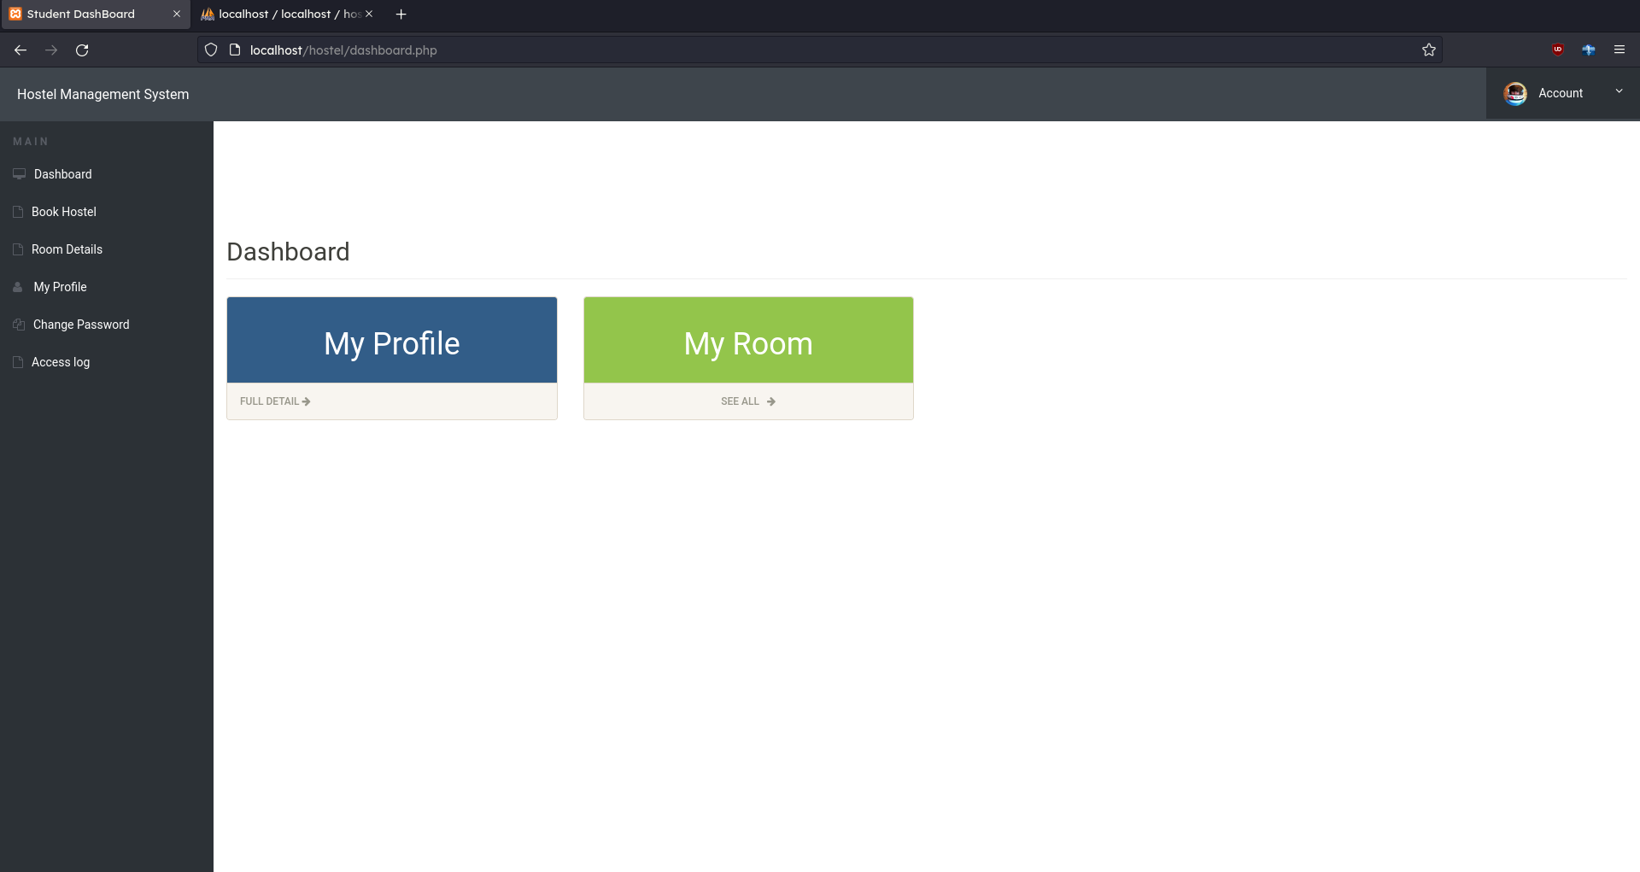
100% Completion :
Student Dashboard:

Slide 28
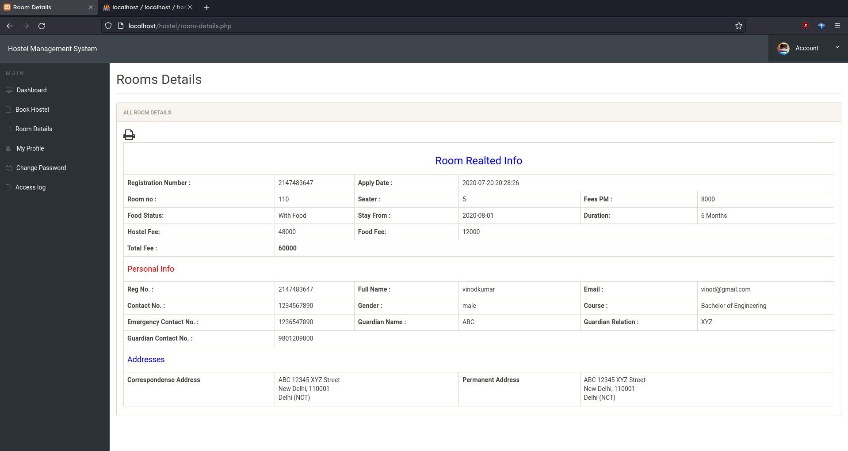
100% Completion :
Student Room Details:

Slide 29
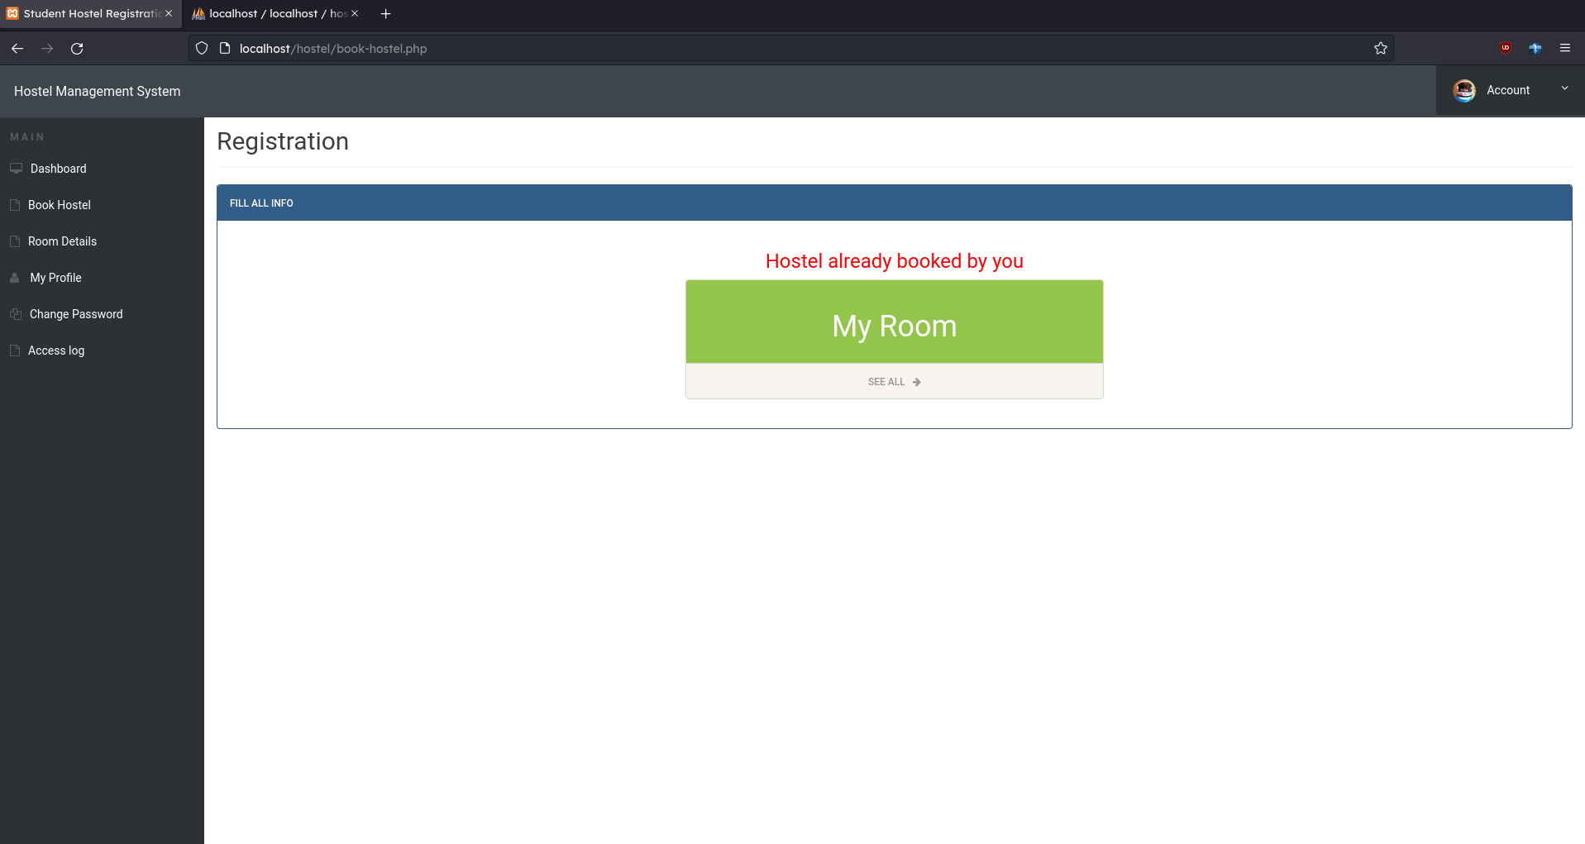
100% Completion :
Student Book Hostel:

Slide 30
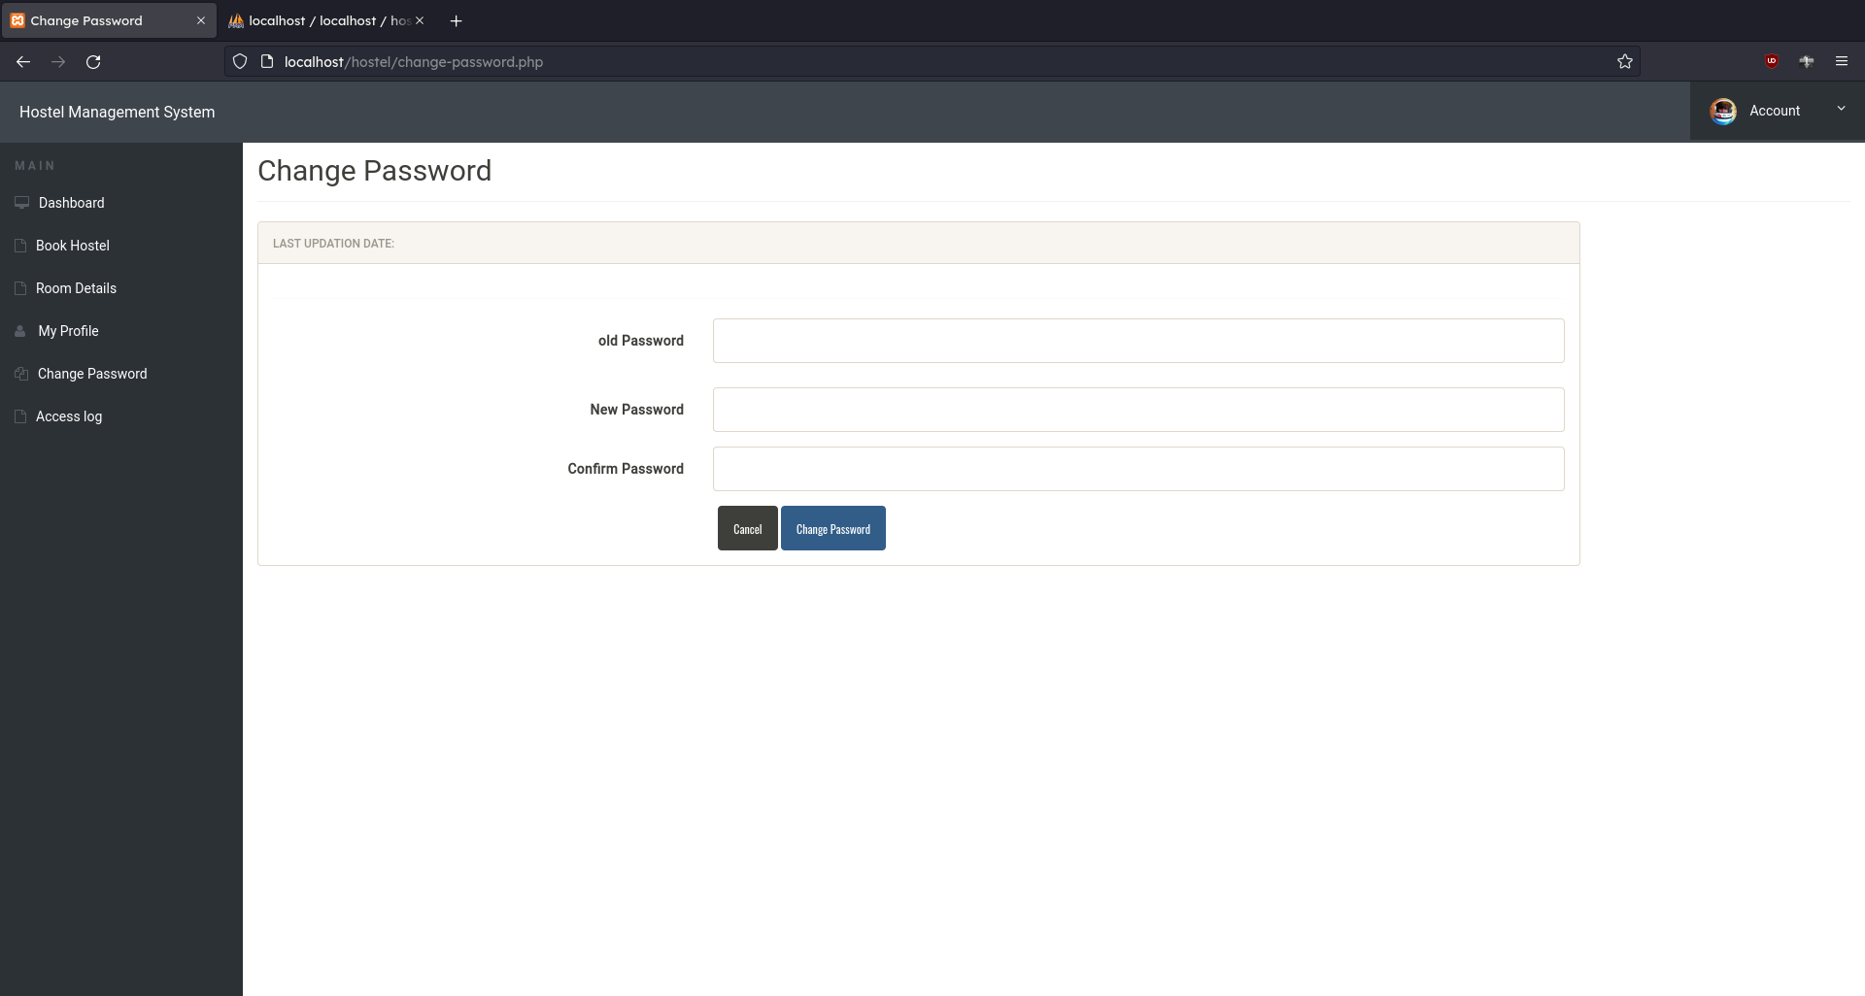
100% Completion :
Student Change Password:

Slide 31
Conclusion
Hostel management system is designed to manage all hostel activities like hostel admissions, fees, room, mess allotment, hostel stores & generates related reports for smooth transactions. It is also used to manage monthly mess bill calculation, students details, room allotment.

Slide 32
Reference
For Languages : https://www.w3schools.com/

